Slide 1
ELYON PHARMACEUTICALS PRIVATE LIMITED

Slide 2
Elyon Pharmaceuticals
At Elyon Pharmaceuticals Private Limited: We offers you best pharmaceutical products at Delhi. Our company presenting high quality and cost effective pharmaceutical products. We are manufacturer and supplier.

Slide 3
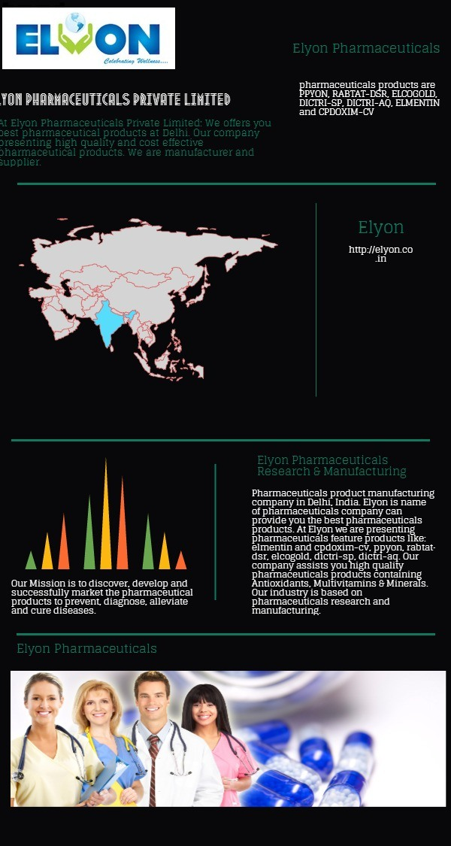
Elyon Pharmaceuticals Services
Pharmaceuticals product manufacturing company in Delhi, India. Elyon is name of pharmaceuticals company can provide you the best pharmaceuticals products. At Elyon we are presenting pharmaceuticals feature products like: elmentin and cpdoxim-cv, ppyon, rabtat-dsr, elcogold, dictri-sp, dictri-aq. Our company assists you high quality pharmaceuticals products containing Antioxidants, Multivitamins & Minerals. Our industry is based on pharmaceuticals research and manufacturing.
Elyon Pharmaceuticals- Elyon is a pharmaceuticals Products manufacturing Company. Elyon offers pharmaceuticals products in Delhi, Our organization have experience team members can provides the best industry based pharmaceuticals products. Our pharmaceuticals products are PPYON, RABTAT-DSR, ELCOGOLD, DICTRI-SP, DICTRI-AQ, ELMENTIN and CPDOXIM-CV. Elyon is one of best and biggest pharmaceuticals industry based company is placed in Delhi, India. All pharmaceuticals products are available at one place that name are Elyon Pharmaceuticals.

Slide 4
Best Pharmaceuticals Company in Delhi- Elyon Pharmaceuticals
Elyon is famous and best to his work to provide pharmaceuticals products. Our pharmaceuticals products collection that covers all pharmaceuticals products including Antioxidants, Multivitamins & Minerals. Our products are being manufactured by WHO GMP, ISO 9001, ISO 14001 certifications, USFDA and UKMHRA approved plants. ELYON Pharmaceuticals is a fastest growing pharmaceuticals company in India. ELYON team is highly skilled, experienced and professional Pharma industry experts. At ELYON we take highest care for the evolution and development of our employees and their families. We believe that our employees are our assets and our industries are best with our work. We believe our employees and our manufactured products that are best in pharmaceuticals industry. Our Mission is to discover, develop and successfully market the pharmaceutical products to prevent, diagnose, alleviate and cure diseases.
Our entire efforts are towards providing total customer satisfaction through excellence in technology and services. Our ultimate aim is “Whatever we do it should be beneficial to all the people, society and nation.” For more information visit here: http://elyon.co.in

